Slide 1

EMPLOYEE RETENTION

Slide 2

Project Name : H R Analytics Employee Retention
By :- MD DANISH ALAM

Slide 3
AGENDA
Business Overview.
Business Problem.
Data Modelling Challenges.
Overview Of Dashboard.
Conclusion And Suggestion.

Slide 4

Business Overview
The business overview would synthesize these insights to provide a HR analytics involves the collection and analysis of HR-related data, including employee data, performance metrics, and other relevant data points. By using advanced analytical tools and techniques, HR analytics provides valuable insights into HR processes and trends, enabling organizations to make more informed decisions about their employees and improve overall performance.

Slide 5
BUSINESS PROBLEM
The aim of this project is to analyze employee retention and attrition rates with the organization and provide insights to the HR team for developing effective retention strategies.
Poor Work-Life Balance: If certain job roles have a poor work-life balance score, this could lead to burnout and increase turnover.
Mismatch of Job Roles and Educational Background: Employees may feel underutilized or unchallenged if their educational background does not align with their job role, leading to job dissatisfaction and potential turnover.
Ineffective Onboarding and Recruitment: The trendline comparing monthly new hires versus attrition could reveal problems with the onboarding process or with how well new hires are matched to their roles.
Low Job Satisfaction: Department or role-wise job satisfaction ratings can highlight areas where employees are not happy with their jobs, which is a direct predictor of turnover.

Slide 6
Data Modeling
1. Identify Key Data Entities:
The Main Entities Might Include Employees, Departments, Roles, Salaries, Surveys (For Satisfaction, Engagement, Etc.), And Promotion History.
2. Define Relationships:
Establish How These Entities Relate To Each Other. For Example:
Employees Belong To Departments And Have Specific Roles.
Salaries Are Associated With Roles And Possibly With Departments.
Surveys Are Filled Out By Employees And Can Be Related To Departments And Roles.
3. Determine Attributes:
Each Entity Will Have Attributes. For Employees, Attributes Could Include Employee ID, Name, Gender, Educational Background, Date Hired, Date Of Last Promotion, Monthly Income, Job Satisfaction Score, Attrition Status, Etc.
4. Create A Fact Table:
A Fact Table In A Star Schema Might Contain Measurable, Quantitative Data About The Business Problem – In This Case, Metrics Like Number Of Employees, Attrition Count, Average Hourly Rate, Etc.

Slide 7
5. Build Dimension Tables: Dimension tables would contain descriptive attributes related to the fact table metrics, such as Employee Demographics, Department Details, Job Role Descriptions, etc. 6. Establish Key Performance Indicators (KPIs): Identify the KPIs for the dashboard, such as Attrition Rate, Average Tenure, Job Satisfaction Level, and link these to the fact table. 7. Data Transformation and Cleaning: The raw data may need to be transformed or cleaned to fit into the model. This might involve standardizing names, filling in missing values, or converting data types. 8. Calculated Fields and Measures: In Power BI, you would also create calculated fields and measures based on the data model, such as calculating the Average Attrition Rate, or creating a measure that filters data by a specific department. 9. Establish Hierarchies: For better analysis, you can create hierarchies, such as Department > Role > Employee, to drill down into the data during analysis.

Slide 8
10. Data Integration: If data comes from multiple sources, it needs to be integrated into a cohesive model, ensuring that all relationships and data types are consistent across the dataset. 11. Security and Compliance: Ensure that the data model respects privacy laws and company policies by implementing security roles and data access rules. 12. Validation: Finally, validate the model by checking if it answers key business questions and allows for the required analysis.

Slide 9
Problem Statement
Average Attrition Rate For All Departments
Average Hourly Rate Of Male Research Scientist
Attrition Rate Vs Monthly Income Stats
Average Working Years For Each Department
Department Wise No Of Employees
Count Of Employees Based On Educational Fields
Job Role Vs Work Life Balance
Attrition Rate Vs Year Since Last Promotion Relation
Gender Based Percentage Of Employee
Monthly New Hire Vs Attrition Trendline
Department / Job Role Wise Job Satisfaction
Marital Status Wise Attrition

Slide 10
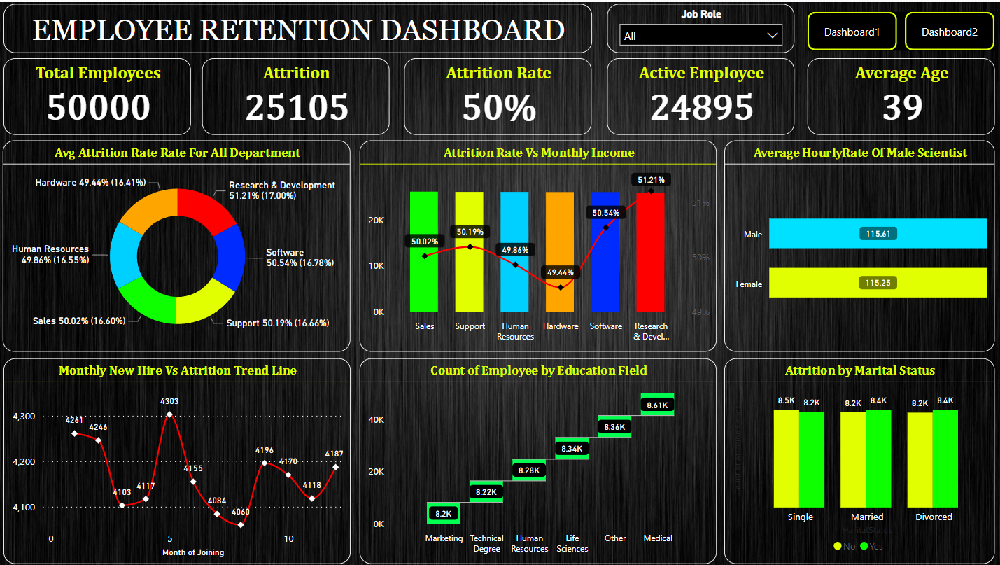

Slide 11
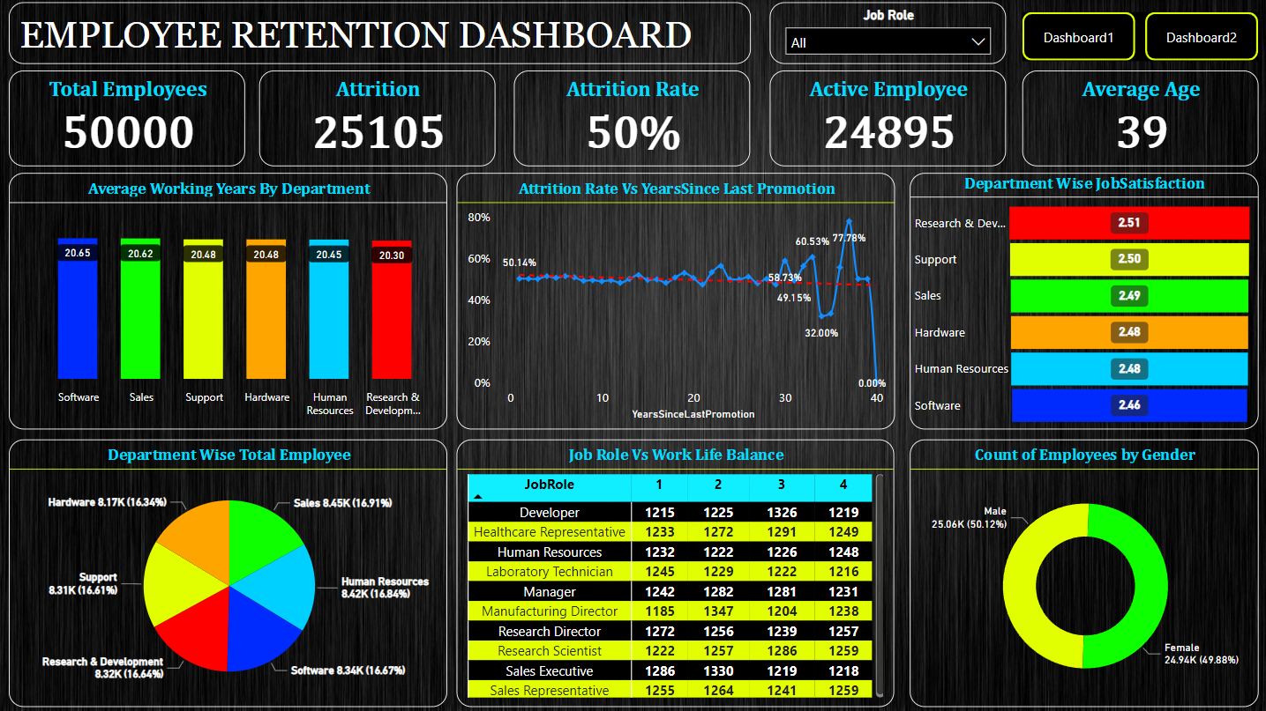

Slide 12
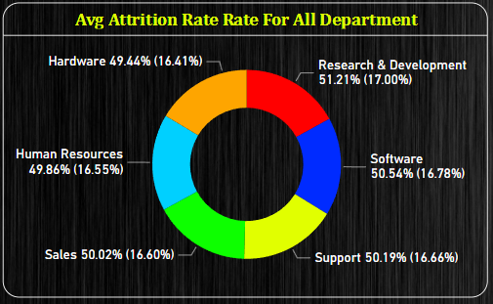
KPI 1
Average Attrition Rate For All Department
This KPI Is To Find Out The Relationship Between Each Department And Its Attrition Rate And Here Attrition Rate Is Highest For Research & Development Department Whereas Lowest Is For Hardware Department.

Slide 13
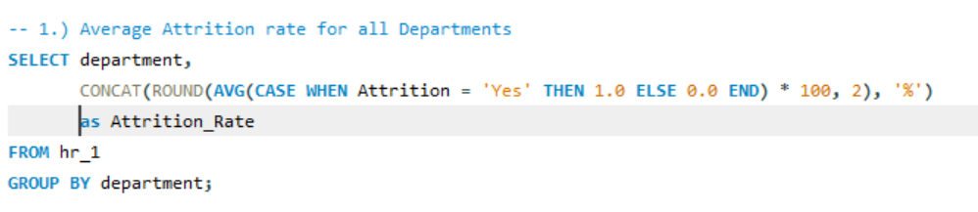
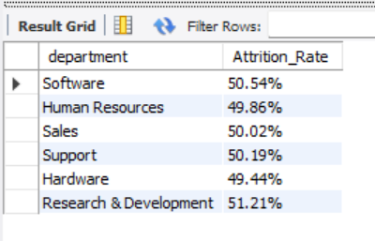
Insights From KPI 1
We Can Clearly Say That Attrition Rate Of Employees For Every Department Is Almost 50% Which Indicates That Attrition Rate Of Employees Does Not Depends On Department. So, Irrespective Of The Department Almost 50% Of Employees Are Leaving The Company.
Actionable Steps:-
Conduct Employee Surveys To Understand The Causes Of Dissatisfaction.
Review Compensation And Benefits To Ensure They Are Competitive.
Consider Implementing Career Development Programs To Provide Growth Opportunities.
Evaluate Work-life Balance Policies To Ensure Employees Are Not Overworked.

Slide 14
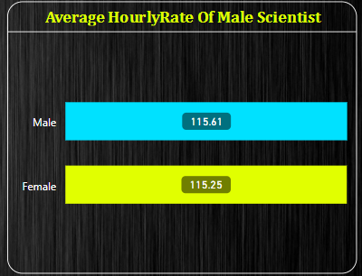
KPI 2
Average Hourly Rate Of Male Scientist
This KPI Is To Find Out The Average Hourly Rate Of Male Research Scientists Which Is 115.61.

Slide 15
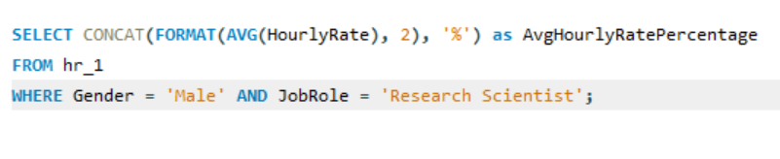
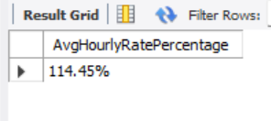
Insights From KPI 2
This Rate May Suggest That Male Research Scientists Are Highly Valued, Reflecting A Competitive Compensation For Their Expertise And Skills Within The Company . If This Rate Is Significantly Higher Than The Industry Average, It Could Indicate The Company's Strategy To Attract Top Talent In Research And Development Roles.
Actionable Steps:
Retention Strategies: If The Rate Is High Due To A Strategy To Retain Top Talent, The Company Should Also Focus On Non-monetary Benefits That Contribute To Job Satisfaction.
Performance Reviews: Implement Regular Performance Reviews To Ensure That The Compensation Is Aligned With Individual Contributions And Market Standards.
Future Planning: Plan For Future Budgeting And Financial Planning, Considering The High Average Hourly Rates For Such Roles, Especially If The Company Plans To Expand Its Research Department.

Slide 16
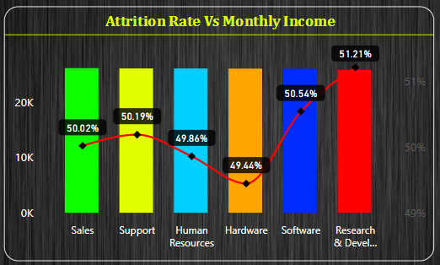
KPI 3
Attrition rate Vs Monthly Income
This KPI Is To Find Out The Relation The Between Monthly Income And Attrition Rate Which Is Taken On Department Basis.

Slide 17
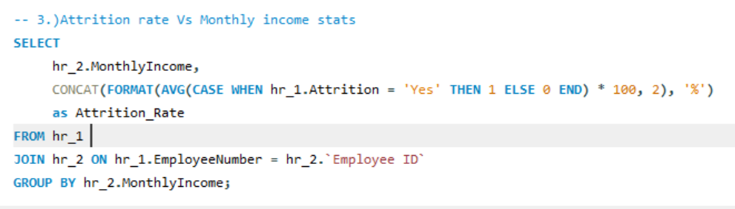
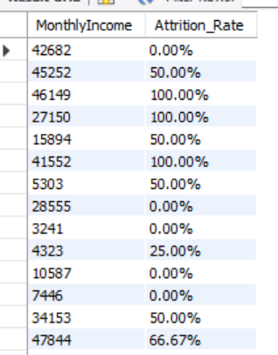
Insights From KPI 3
The Analysis Of The Attrition Rate Vs Monthly Income Stats Shows That Employees With Higher Attrition Have A Higher Average Monthly Income Than Those With Lower Attrition. This Suggests That Salary May Not Be A Significant Factor In Employee Retention.
Actionable Steps:
Career Pathing: Provide Clear Career Progression Opportunities That Allow For Salary Growth To Retain Talent.
Competitive Pay: Review And Adjust The Pay Scales To Ensure They Are Competitive Within The Industry To Help Reduce Attrition Due To Pay Dissatisfaction.
Other Factors, Such As Job Satisfaction, Work-life Balance, And Career Development Opportunities, May Be More Important Than Salary In Driving Employee Retention.
Employees With Higher Salaries May Be More Likely To Leave For New Opportunities, Even If They Are Satisfied With Their Current Job.

Slide 18
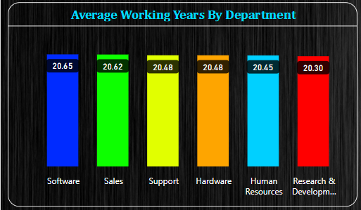
KPI 4
Average Working Years By Department
This KPI Shows The Average Working Years Of Each Department.

Slide 19
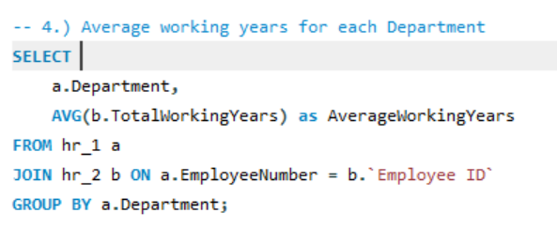
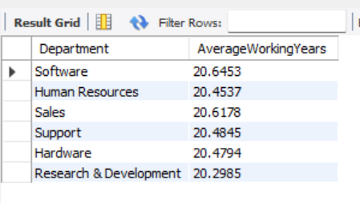
Insights From KPI 4
Analyzing the average working years by department can provide valuable insights into workforce dynamics, employee satisfaction, and career longevity within an organization.
Succession Planning:
Departments with longer average working years may have more stable teams, facilitating better succession planning and knowledge retention.
Work-Life Balance:
Departments with longer average working years might be promoting a healthy work-life balance, which can contribute to employee satisfaction and retention.
Employee Engagement and Job Satisfaction:
Longer average working years might suggest higher levels of employee engagement and job satisfaction within a department. Employees are likely to stay in roles they find fulfilling.
Career Progression Opportunities:
Departments with shorter average working years may lack clear career progression opportunities. Employees may leave in search of better advancement prospects elsewhere.
Departmental Job Stability:
Departments with longer average working years may indicate greater job stability and employee satisfaction.

Slide 20
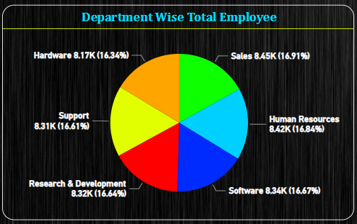
KPI 5
Department Wise Total Employees
This KPI Shows The Total Employee On Each Department And The Percentage Of Total By Department.

Slide 21
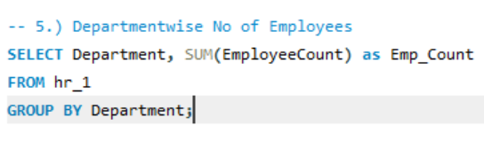
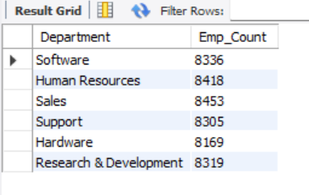
Insights From KPI 5
Analyzing Department-wise Total Employees Can Provide Valuable Insights Into The Organizational Structure, Resource Distribution, And Potential Areas Of Focus.
Insights:
The Sales Department Has The Highest Number Of Employees, Which May Suggest A Business Focus On Sales Activities And Market Expansion .
Human Resources Also Has A Large Number Of Employees, Indicating Significant Investment In Managing The Company's Human Capital .
Departments Like Software, Support, And Hardware Have A Substantial Number Of Employees, Reflecting The Company's Emphasis On Technology And Product/Service Support .
Research & Development Has A Robust Number Of Employees, Which Is Essential For Innovation And Maintaining A Competitive Edge In The Market.

Slide 22
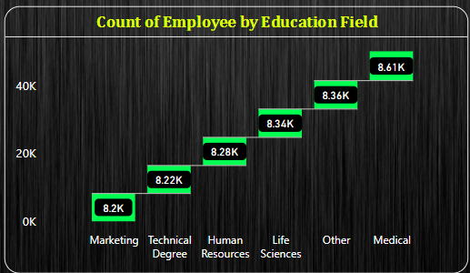
KPI 6
Count Of Employees By Educational Field
This KPI Shows The Total Count Of Employee Based On Educational Fields.

Slide 23
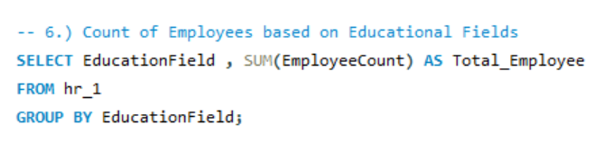
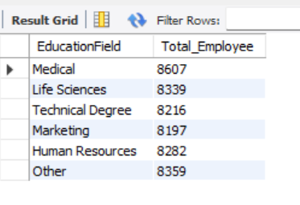
Insights From KPI 6
Analyzing the count of employees by educational field can offer insights into the skill composition, potential areas for talent development, and alignment of workforce skills with organizational needs.
Insights:
A significant number of employees come from a Medical background, which could be beneficial if the company is involved in healthcare or requires medical expertise . The representation of employees with backgrounds labeled as Other suggests diversity in educational qualifications, which can lead to a rich mix of skills and perspectives within the workforce.
The presence of employees from Life Sciences and those with Technical Degrees indicates a strong science and technology focus, which is essential for companies in the tech or scientific research sectors.
Having a sizable number of employees from Human Resources and Marketing educational fields implies that the company values expertise in these areas, which are critical for managing people and market presence.

Slide 24
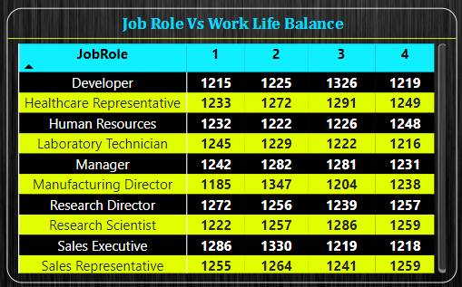
KPI 7
Job Role Vs Work Life Balance
This KPI Shows The Job Satisfaction Of Employee Based On Job Role Where 1 Is Poor Is And 4 Is Excellent

Slide 25
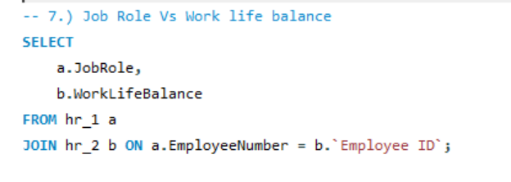
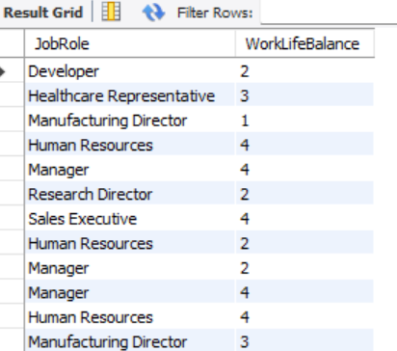
Insights From KPI 7
Insights:
Job Role Demands: Some job roles may inherently come with more stress or irregular hours, which can impact work-life balance negatively.
Employee Feedback: Employees in roles with lower work-life balance ratings might be experiencing stress due to overtime, inflexible schedules, or workload.

Slide 26
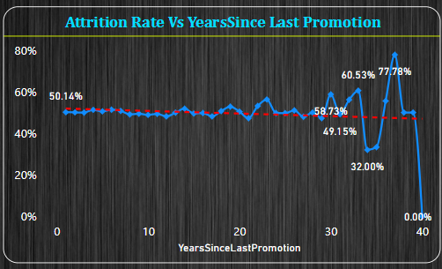
KPI 8
Attrition Rate Vs Year Since Last Promotion
This KPI Shows The Attrition Rate And Year Since Last Promotion So We Can See Years Wise Attrition.

Slide 27
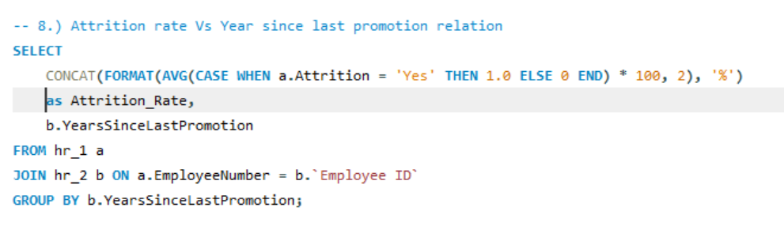
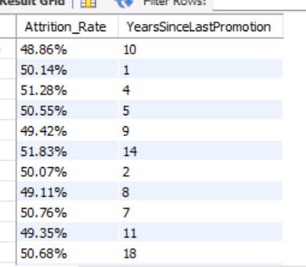
Insights From KPI 8
Analyzing the relationship between attrition rate and the number of years since the last promotion can offer insights into employee satisfaction, career development, and potential areas for improvement.
Insights:
High Attrition at Long Intervals: The highest attrition rates occur at longer intervals since the last promotion, such as 33, 37, and 39 years. This could suggest that employees are more likely to leave if they perceive a lack of advancement or recognition over time.
Lowest Attrition: Interestingly, the lowest attrition rate is observed at 40 years since the last promotion. This may be due to a very small sample size or indicate employees nearing retirement who are less likely to leave.
Mid-Range Variance: Throughout the mid-range of years since the last promotion (from 1 to 25 years), the attrition rates fluctuate around 50%, suggesting that factors other than time since the last promotion may also significantly influence attrition.

Slide 28
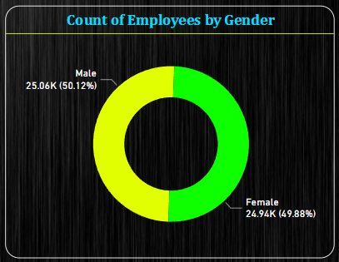
KPI 9
Count Of Employees By Gender
This KPI Shows The Total Count And Percentage Of Employee Based On Gender.

Slide 29
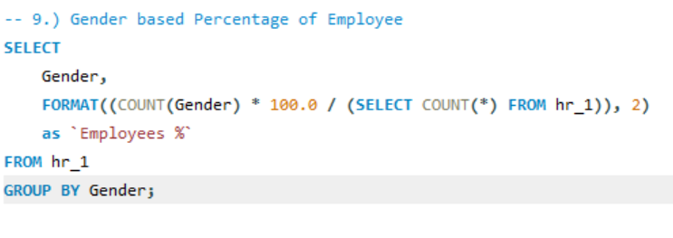
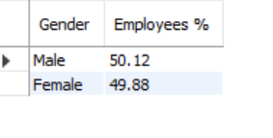
Insights From KPI 9
Analyzing the count of employees by gender can provide insights into various aspects of an organization's workforce composition, diversity, and inclusivity.
Insights:
The gender distribution at this company is nearly equal, which is a positive sign of gender diversity in the workplace.
Maintain Balance: Continue with recruitment and promotion policies that support this balance to maintain gender diversity.
Diversity Training: Even with a balanced distribution, it's important to have regular diversity and inclusion training to ensure a supportive work environment for all genders.

Slide 30
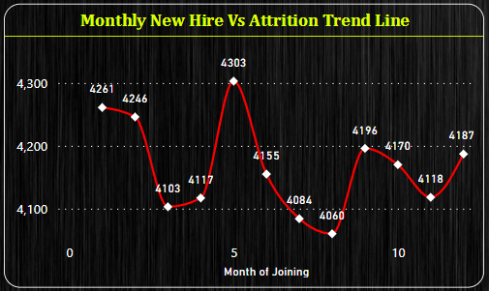
KPI 10
Monthly New Hire Vs Attrition Trend Line
This KPI Shows The Monthly New Hire And Attrition Trend Line.

Slide 31
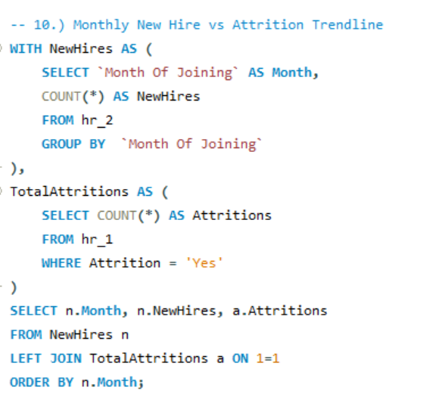
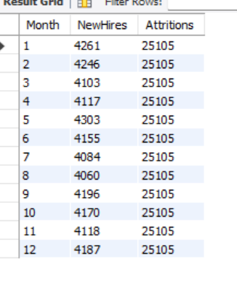
Insights From KPI 10
Analyzing the trend line of monthly new hires versus attrition can provide valuable insights into workforce dynamics, organizational health, and potential areas for improvement.
Insights:
Consistent Attrition: Attrition numbers remain constant each month at 25,105, which is unusually high and suggests a systematic issue rather than a seasonal or one-off event.
New Hires Fluctuations: New hires fluctuate slightly month to month but remain significantly lower than attritions, indicating a shrinking workforce.
Workforce Reduction: If attritions continue to outpace new hires by this margin, the company is experiencing a net reduction in workforce, which can have several implications, such as increased workload on remaining employees and potential loss of expertise.

Slide 32
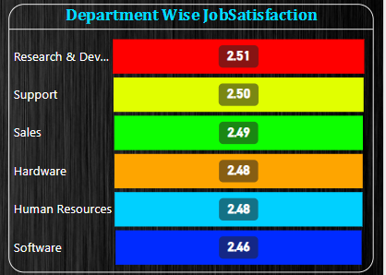
KPI 11
Department Wise Job Satisfaction
This KPI Shows The Job Satisfaction Rate Based On The Department.

Slide 33
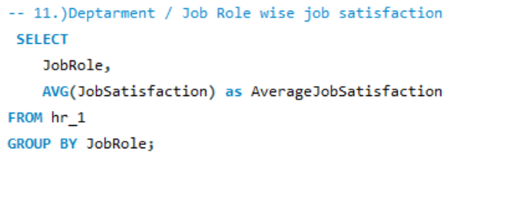
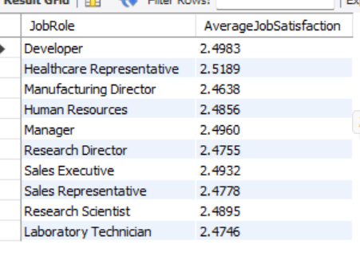
Insights From KPI 11
Analyzing Department-wise Total Employees Can Provide Valuable Insights Into The Organizational Structure, Resource Distribution, And Potential Areas Of Focus.
Insights:
Overall Satisfaction: The average job satisfaction scores across different job roles are quite close, ranging narrowly between 2.46 and 2.52 on an unspecified scale. This suggests a relatively uniform level of job satisfaction across the company.
Potential for Improvement: All scores are below the midpoint of a 1-5 scale (assuming this is the scale used), which indicates there is room for improvement in job satisfaction across all roles.

Slide 34
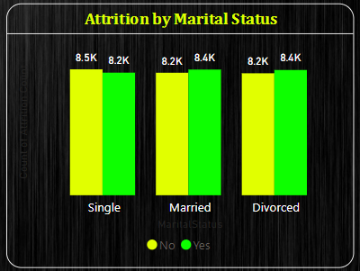
KPI 12
Attrition By Marital Status
This KPI Shows Attrition Count Based On The Marital Status By Gender.

Slide 35
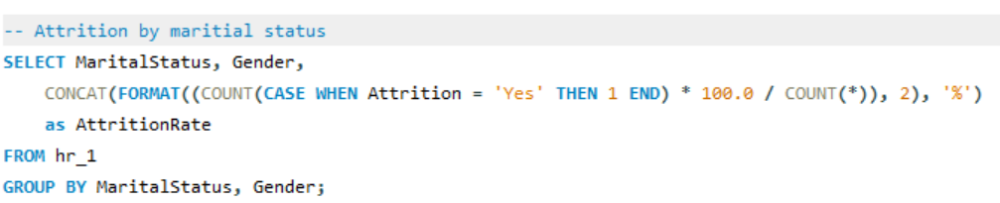
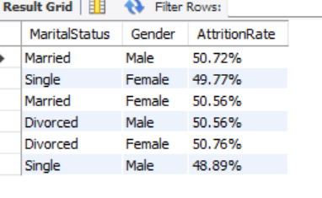
Insights From KPI 12
Analyzing gender-wise attrition by marital status can provide insights into potential patterns, challenges, and opportunities related to workforce dynamics.
Insights:
Attrition Distribution: Attrition is distributed across all marital statuses and both genders. Notably, married males have the highest attrition count, followed closely by single females and divorced females.
Marital Status Impact: Being married or divorced doesn't significantly differ in attrition when comparing males and females, suggesting factors other than marital status may influence the decision to leave.
Gender Consideration: Male attrition is higher in both the married and divorced categories, which could indicate gender-specific issues or external job market opportunities.

Slide 36
Conclusion & Suggestion
Based On The All Conclusions, The Following Strategic Suggestions Can Be Made To Improve Retention:
Review Compensation Structures: Conduct A Market Analysis To Ensure Competitive And Fair Compensation For All Roles, With Adjustments Made Where Necessary.
Enhance Career Development Programs: Create Clear Career Pathways And Promote Continuous Learning And Development Opportunities.
Improve Work-life Balance: Implement Policies That Support Flexible Work Schedules, Telecommuting Options, And Ensure Workloads Are Manageable.
Refine Onboarding Processes: Strengthen The Onboarding Program To Better Integrate New Hires Into The Company Culture And Clarify Role Expectations.
Leadership Training: Train Managers And Leaders In Effective People Management, Focusing On Communication, Feedback, And Recognition.

Slide 37
Thank You..

